Slide 1
Introduction to different types of variables in Python
Stephen R. Addison, PhD
June 6, 2023

Slide 2
Basic Information
My sessions are focused on Python, I’ll be talking in general about Matrix operations, but I will do some examples in Python. I’ll also tell you where you can find my materials. If you haven’t been in the other Python sessions, you will still be able to follow along.

Slide 3
Arithmetic Operations
We have already explored the basic arithmetic operations in Python, the details and examples will be posted in the student binder. I’m going to focus on variable types in Python.
Arrays aren’t really supported in Python - so I am going to show you how to use a supported object that can be used to duplicate the behavior of an array. I’ll then show you how we really deal with arrays using the numpy module.

Slide 4
Python data types that store multiple items in a single variable
There are 4 built-in data types in Python that are used to store multiple items in a single variable these are
List
Tuple
Set
Dictionary
They all have different properties and usages. We’ll explore this briefly

Slide 5
List
List are created with square brackets. List items are ordered, changeable , and allow duplicate values.
So in Python, the code for creating a list is
Newlist = [“car”, “boat”, “plane”, “train”]
And you can print it with the command
print(Newlist)
It is ordered because the items have a defined order. The items are indexed, the first item has index [0]

Slide 6
List (continued)
If you add items to the list, they will be added to the end. We can add or remove items in lists after they have been created. Lists allow duplicate entries.
To determine the length of a list we use the len() function
Here is how it is used
print(len(Newlist))

Slide 7
List Items - Data Types
list1 = ["apple", "banana", "cherry"]
list2 = [1, 5, 7, 9, 3]
list3 = [True, False, False]
The above examples are string, integer, and boolean types

Slide 8
Python Collections (Arrays)
There are four collection data types in the Python programming language:
List is a collection which is ordered and changeable. Allows duplicate members.
Tuple is a collection which is ordered and unchangeable. Allows duplicate members.
Set is a collection which is unordered, unchangeable*, and unindexed. No duplicate members.
Dictionary is a collection which is ordered** and changeable. No duplicate members.
*Set items are unchangeable, but you can add or remove items.
** dictionary items became ordered as of Python 3.7.

Slide 9
NumPy
NumPy is a Python library, among other things it is used for working with arrays. It is short for Numerical Python. NumPy also does linear algebra, and general matrix operations.
We could use lists, but they are slow to process. NumPy is much faster.
Arrays are used very frequently in data science where speed is important. You have seen examples already when we used the pandas dataframe.

Slide 10
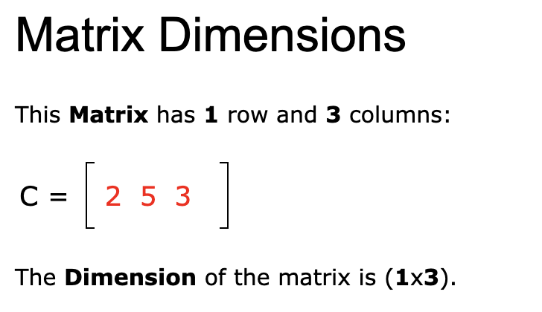
Matrices
A matrix is set of Numbers, in a Rectangular Array, arranged in Rows and Columns.

Slide 11
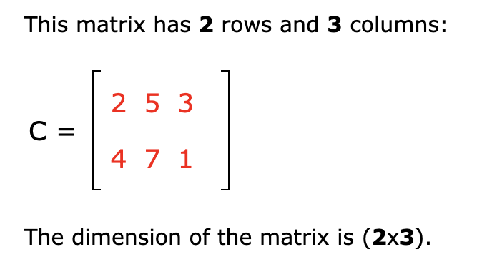

Slide 12
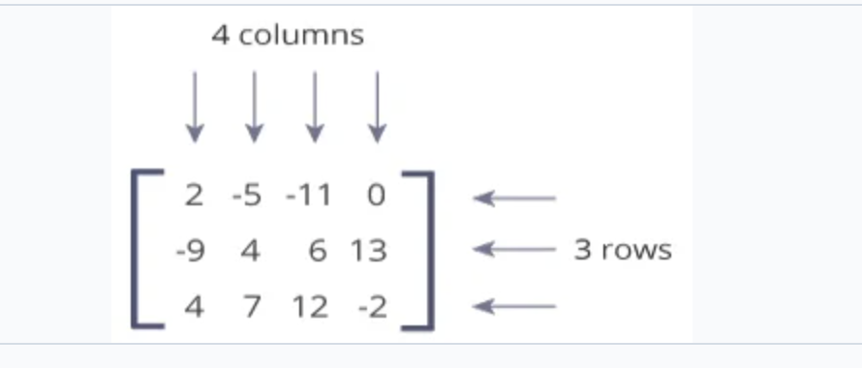
Matrix
We say this is a 3X4 matrix

Slide 13
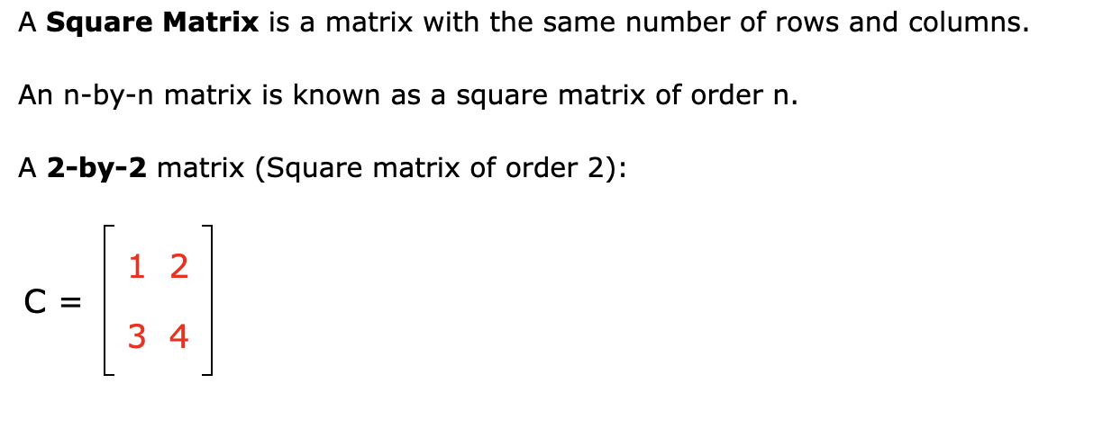
Square Matrices

Slide 14
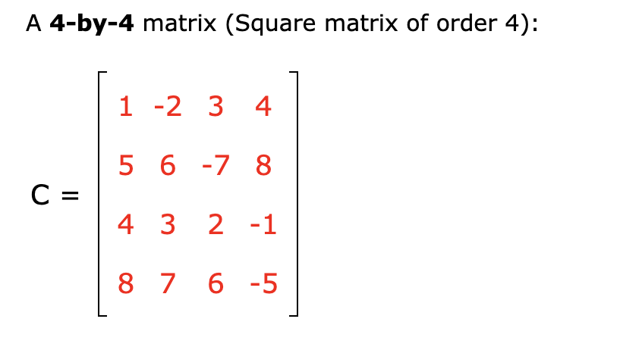

Slide 15
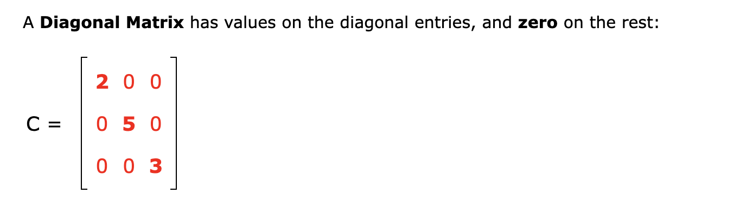
Diagonal Matrix

Slide 16
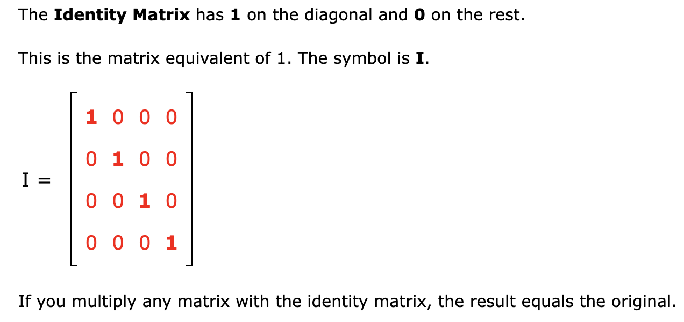
Identity Matrix

Slide 17
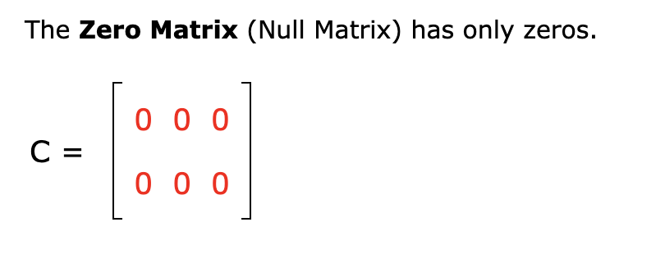
Zero Matrix

Slide 18
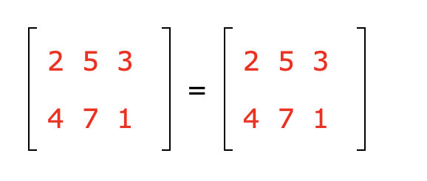
Equal Matrices
A matrix is equal to another matrix if each element in one corresponds with
The element in the other.
These matrices are equal

Slide 19
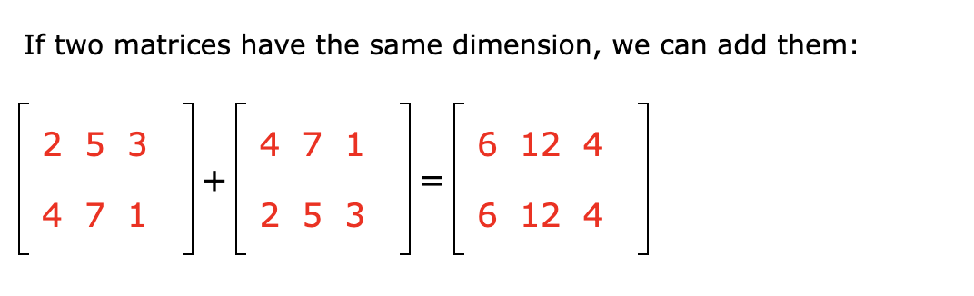
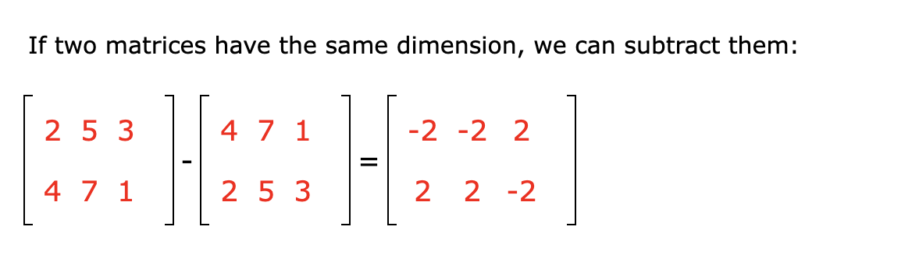
Matrix Addition

Slide 20
Scalar Multiplication
Numbers in rows and columns are called matrices, single numbers are scalars. It is easy to multiply a scalar by a matrix.

Slide 21
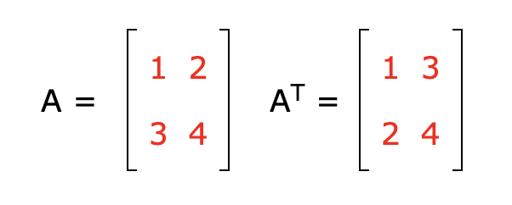
Transpose of a Matrix
To transpose a matrix, we replace the rows with the columns, basically you reflect it about it diagonal

Slide 22
Matrix Multiplication
This is where the fun starts.
We can only multiply two matrices if the number of rows in matrix A is the same as the number of columns in matrix B.

Slide 23
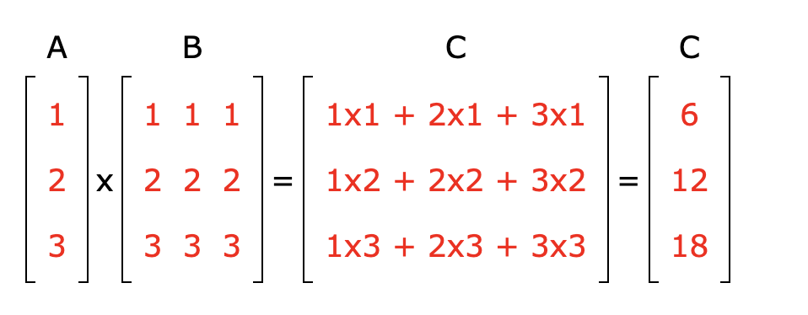
Matrix Multiplication

Slide 24
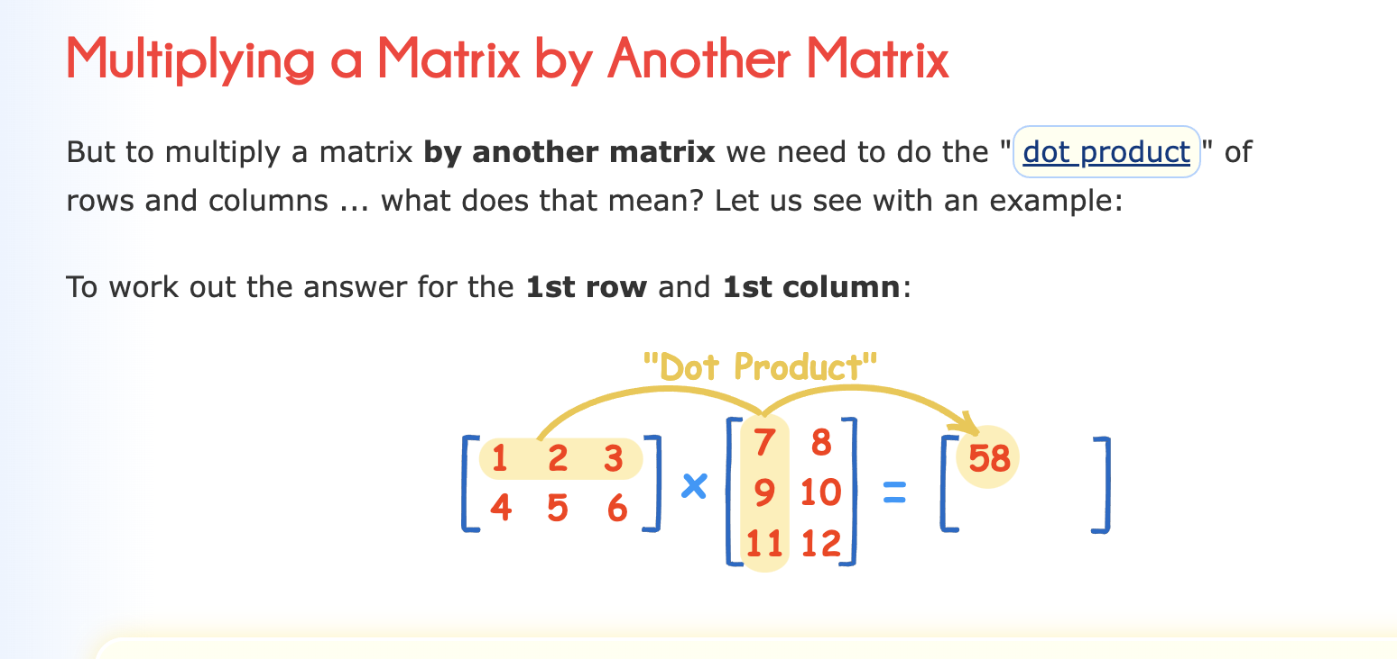
Another Example

Slide 25
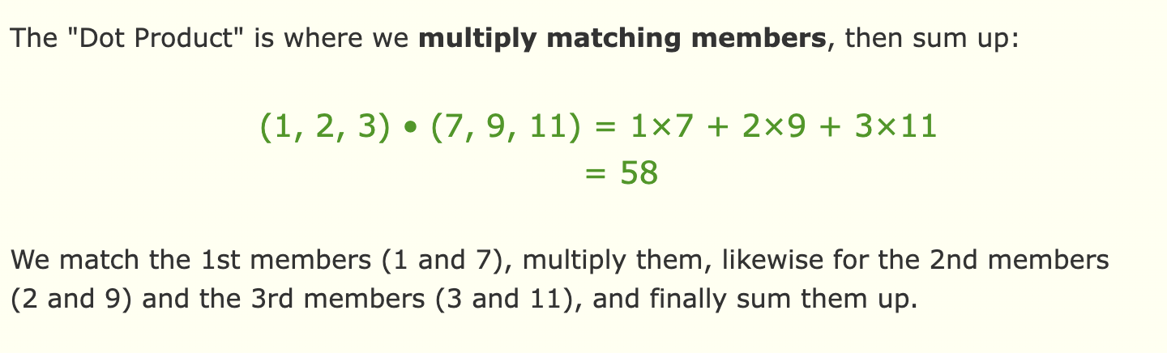
Details

Slide 26
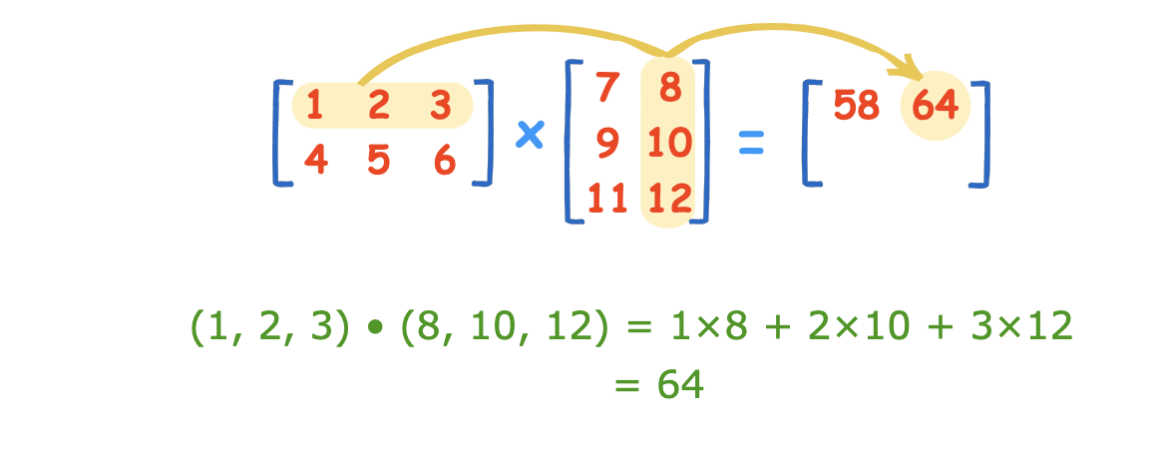
Details

Slide 27
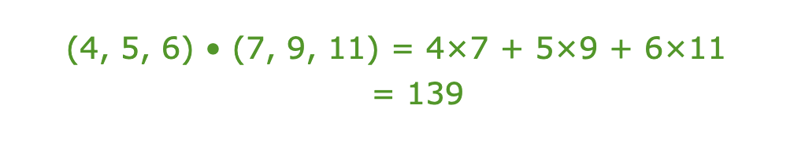
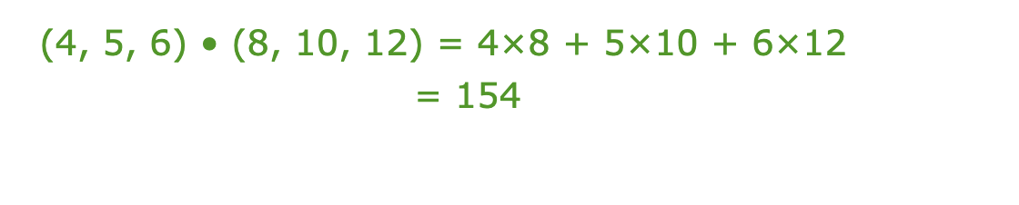
Details

Slide 28
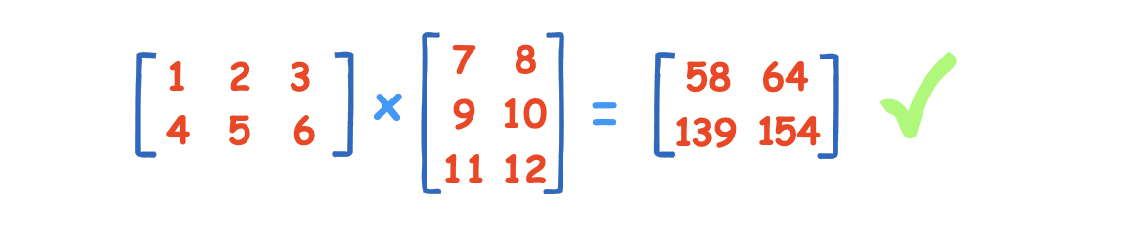
Result

